Slide 1

Department of Information Technology
Major Project
on
Lung Cancer Detection using CNN
Presented by:
Mohammed Anas(160922737028)
Mohd Wali Uddin(160922737004)
Amal Jameel (160922737017)
Guide Name:
Mr.M Sivaramakrishna
Assistant Professor

Slide 2

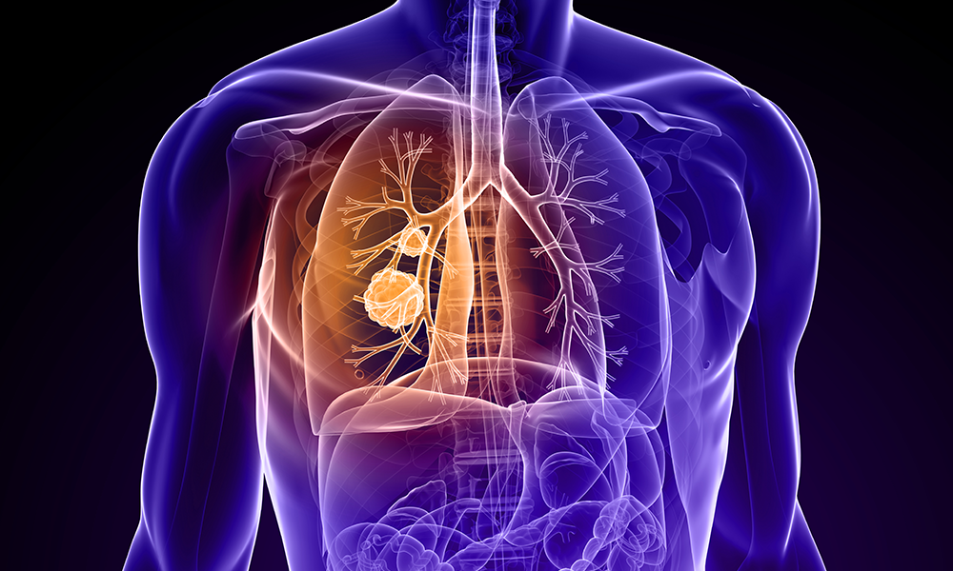
Contents
Introduction
Abstract
Existing System
Proposed System
Implementation
Conclusion

Slide 3
What is Lung Cancer and Why is it Important to Detect?
Lung Cancer:
Lung cancer is a disease where abnormal cells grow uncontrollably in the lungs.
It is one of the leading causes of cancer-related deaths worldwide.
Importance of Early Detection:
Increases survival rate
Helps start treatment early
Reduces spread of cancer
Saves lives

Slide 4
Abstract
Lung cancer continues to be a leading cause of death globally.
Early detection is crucial for improving survival rates.
Deep learning offers potential for accurate and automated diagnosis.
This project integrates InceptionV3, MobileNetV2, Xception, and ResNet-50 models.
The goal is to classify CT scan images as malignant or benign efficiently.

Slide 5
Problem Statement
Manual diagnosis is time-consuming and prone to human error.
Subtle or irregular nodules are difficult to detect.
Existing systems lack automation and high accuracy.
Need for early, reliable, and scalable detection methods.
Integration of AI and healthcare is necessary for improvement.

Slide 6
Existing System
Manual X-ray Examination
Often misses small nodules.
Low clarity and high chances of human error. Not suitable for early-stage cancer detection
2.Traditional CT Scan Reading by Radiologist
Tiny nodules can be overlooked.
Inconsistent results due to varying radiologist expertise.
Time-consuming to analyze many scan slices

Slide 7
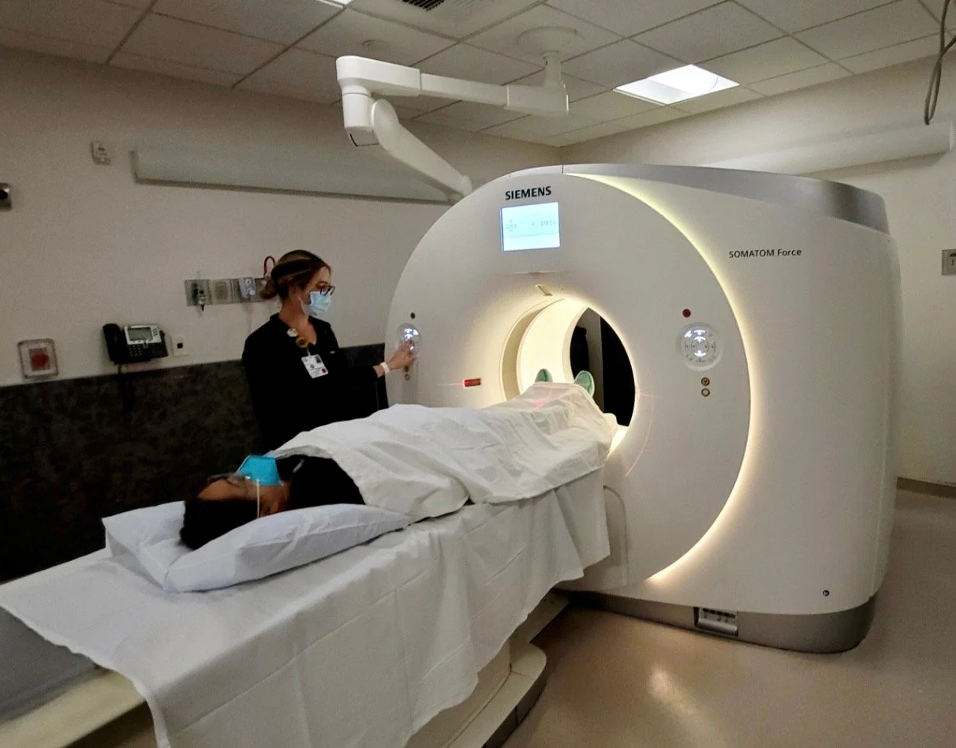
3. Rule-Based Computer-Aided Detection (Old CAD Systems)
Uses fixed rules such as size or shape thresholds.
Cannot detect irregular or complex tumor patterns.
Generates many false positives.
Not adaptive to new data or variations in scans
4. MRI (Traditional Imaging System)
Poor imaging quality in lungs due to
air-filled structures.
Not effective for early lung cancer.
Mostly used for detecting tumor spread, not initial detection

Slide 8
Objectives
Develop an automated system for lung cancer detection using CT scans.
Utilize multiple deep learning architectures for comparison.
Enhance diagnostic accuracy and reduce human dependency.
Provide faster diagnosis for better treatment outcomes.

Slide 9
Drawbacks of Existing System
High error rate in diagnosis.
Time-consuming image review process.
Limited accuracy in complex lesion detection.
Inefficient in large-scale screening.
No self-learning capability or adaptation.

Slide 10
Proposed System
• Implements deep learning-based image analysis.
• Integrates pre-trained CNN architectures (InceptionV3, MobileNetV2, Xception, ResNet-50).
• Automates lung nodule identification and classification.
• Uses transfer learning to boost efficiency.
• Focuses on robust and scalable detection framework.

Slide 11
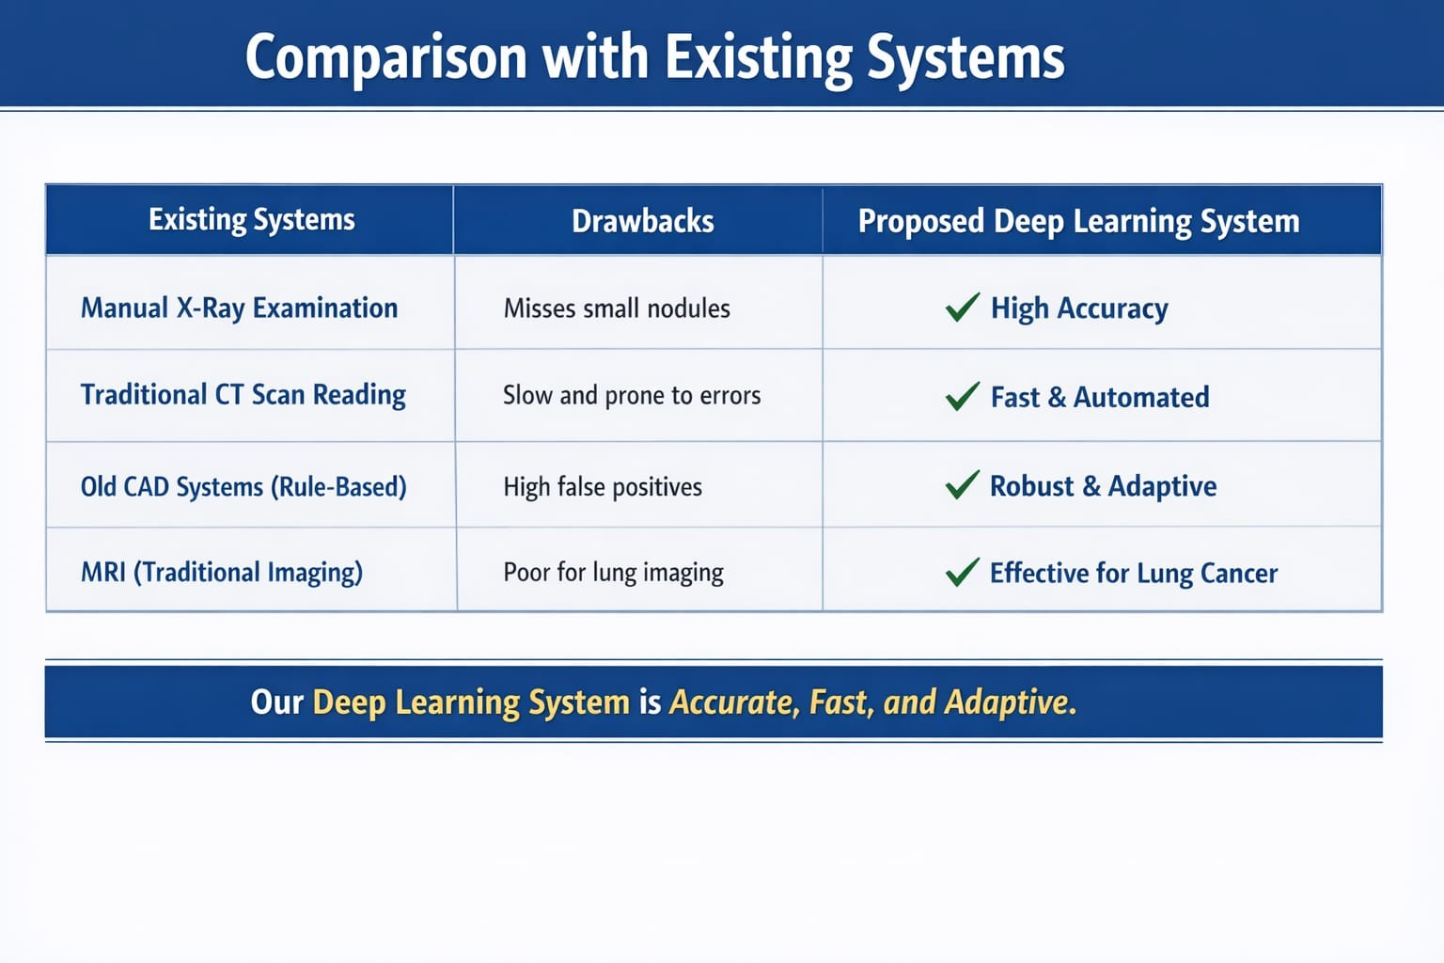
Comparison table

Slide 12
Advantages of Proposed System
Higher accuracy and faster diagnosis.
Reduced human error in detection.
Efficient feature extraction using deep CNNs.
Improved patient care through early detection.
Can be extended to other medical imaging tasks.

Slide 13
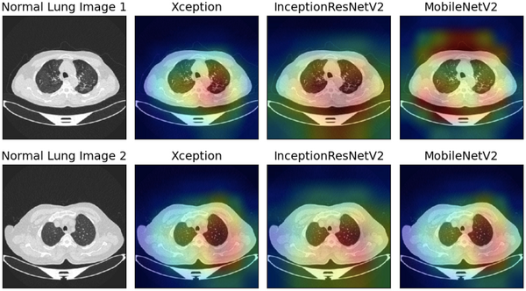
Using CT Scans

Slide 14
System Modules
Data Acquisition: Collect CT scan images of lungs.
Preprocessing: Enhance image quality and remove noise.
Model Training: Use CNN architectures with transfer learning.
Feature Extraction: Extract patterns and nodules from images.
Classification: Identify malignant vs benign tissues.

Slide 15
Software Requirements
Python 3.x
TensorFlow / Keras
NumPy, OpenCV, Matplotlib
Scikit-learn
Jupyter Notebook or Google Colab

Slide 16

Hardware Requirements
Processor: Intel i5/i7 or equivalent
RAM: Minimum 8 GB
GPU: NVIDIA GPU (for model training)
Storage: Minimum 10 GB free space
High-resolution display for visualization

Slide 17
System Architecture
Input: CT scan image dataset.
Preprocessing and segmentation of lung images.
Feature extraction using deep CNN models.
Classification into malignant or benign categories.
Output: Diagnosis result displayed for review.

Slide 18
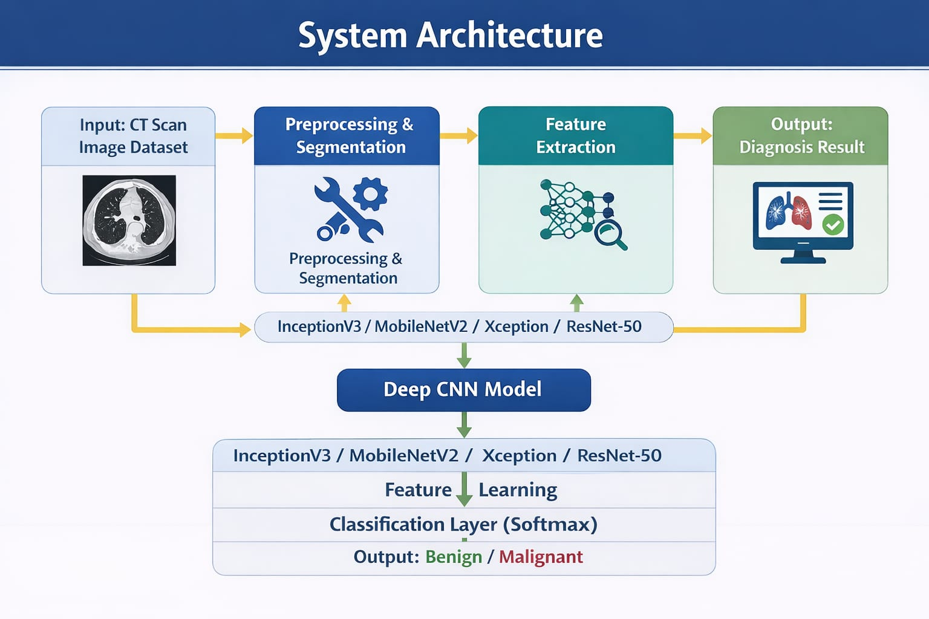

Slide 19
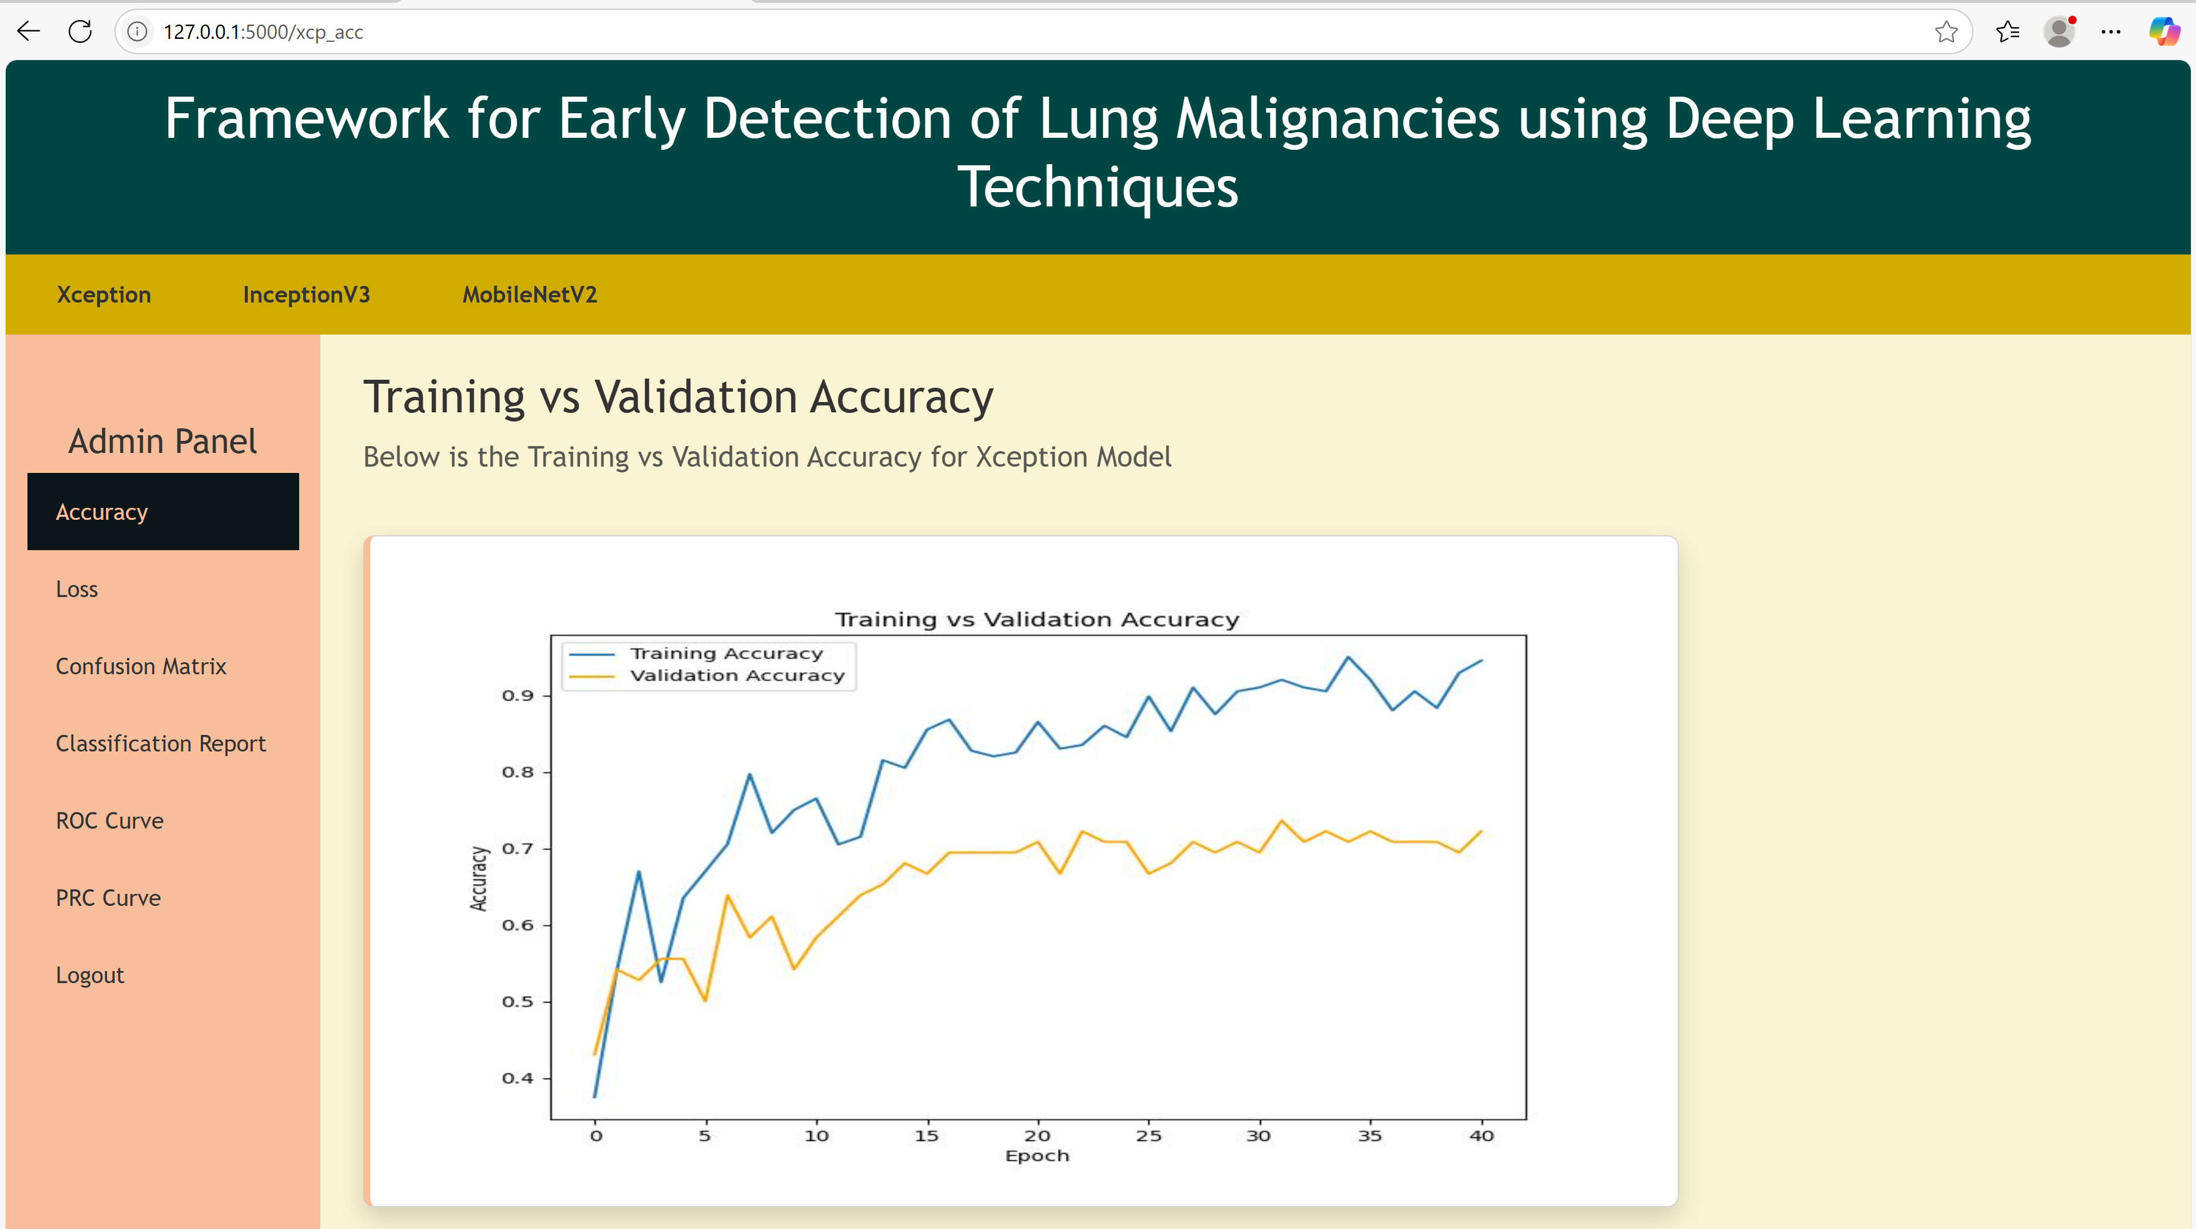
Results

Slide 20
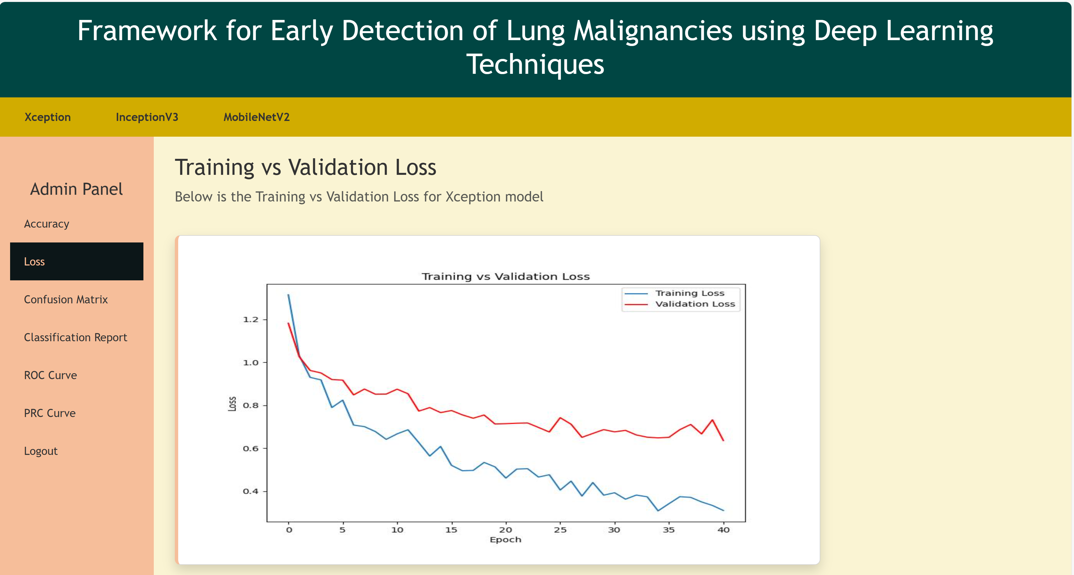

Slide 21
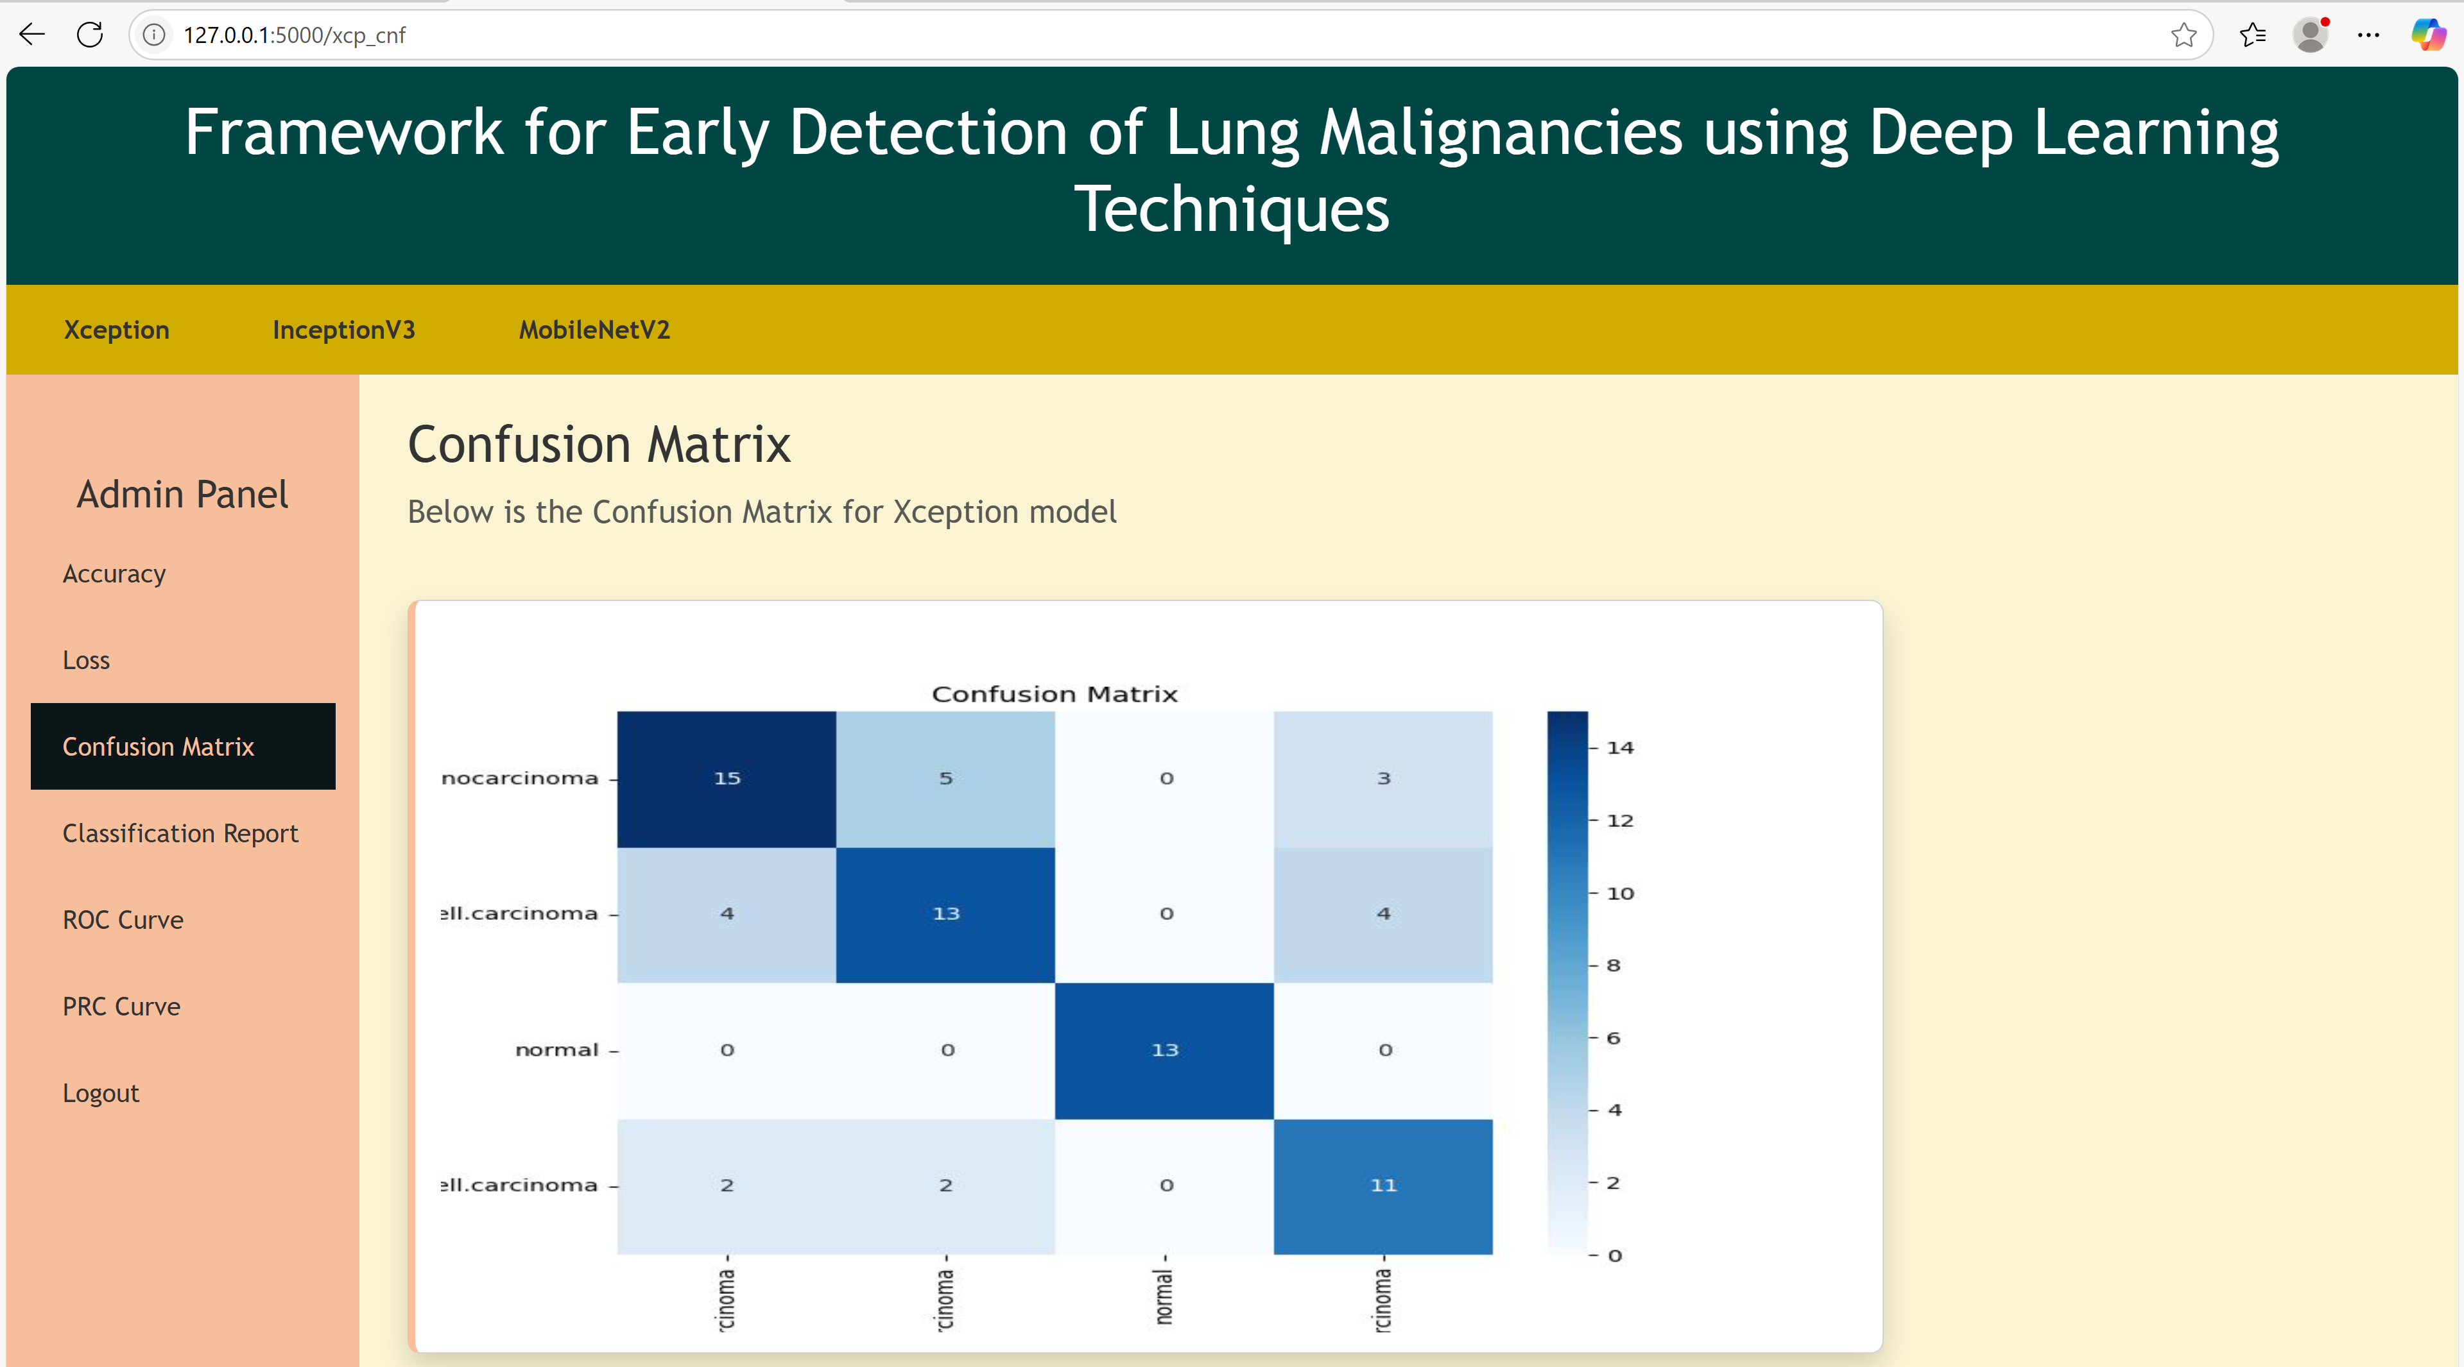

Slide 22
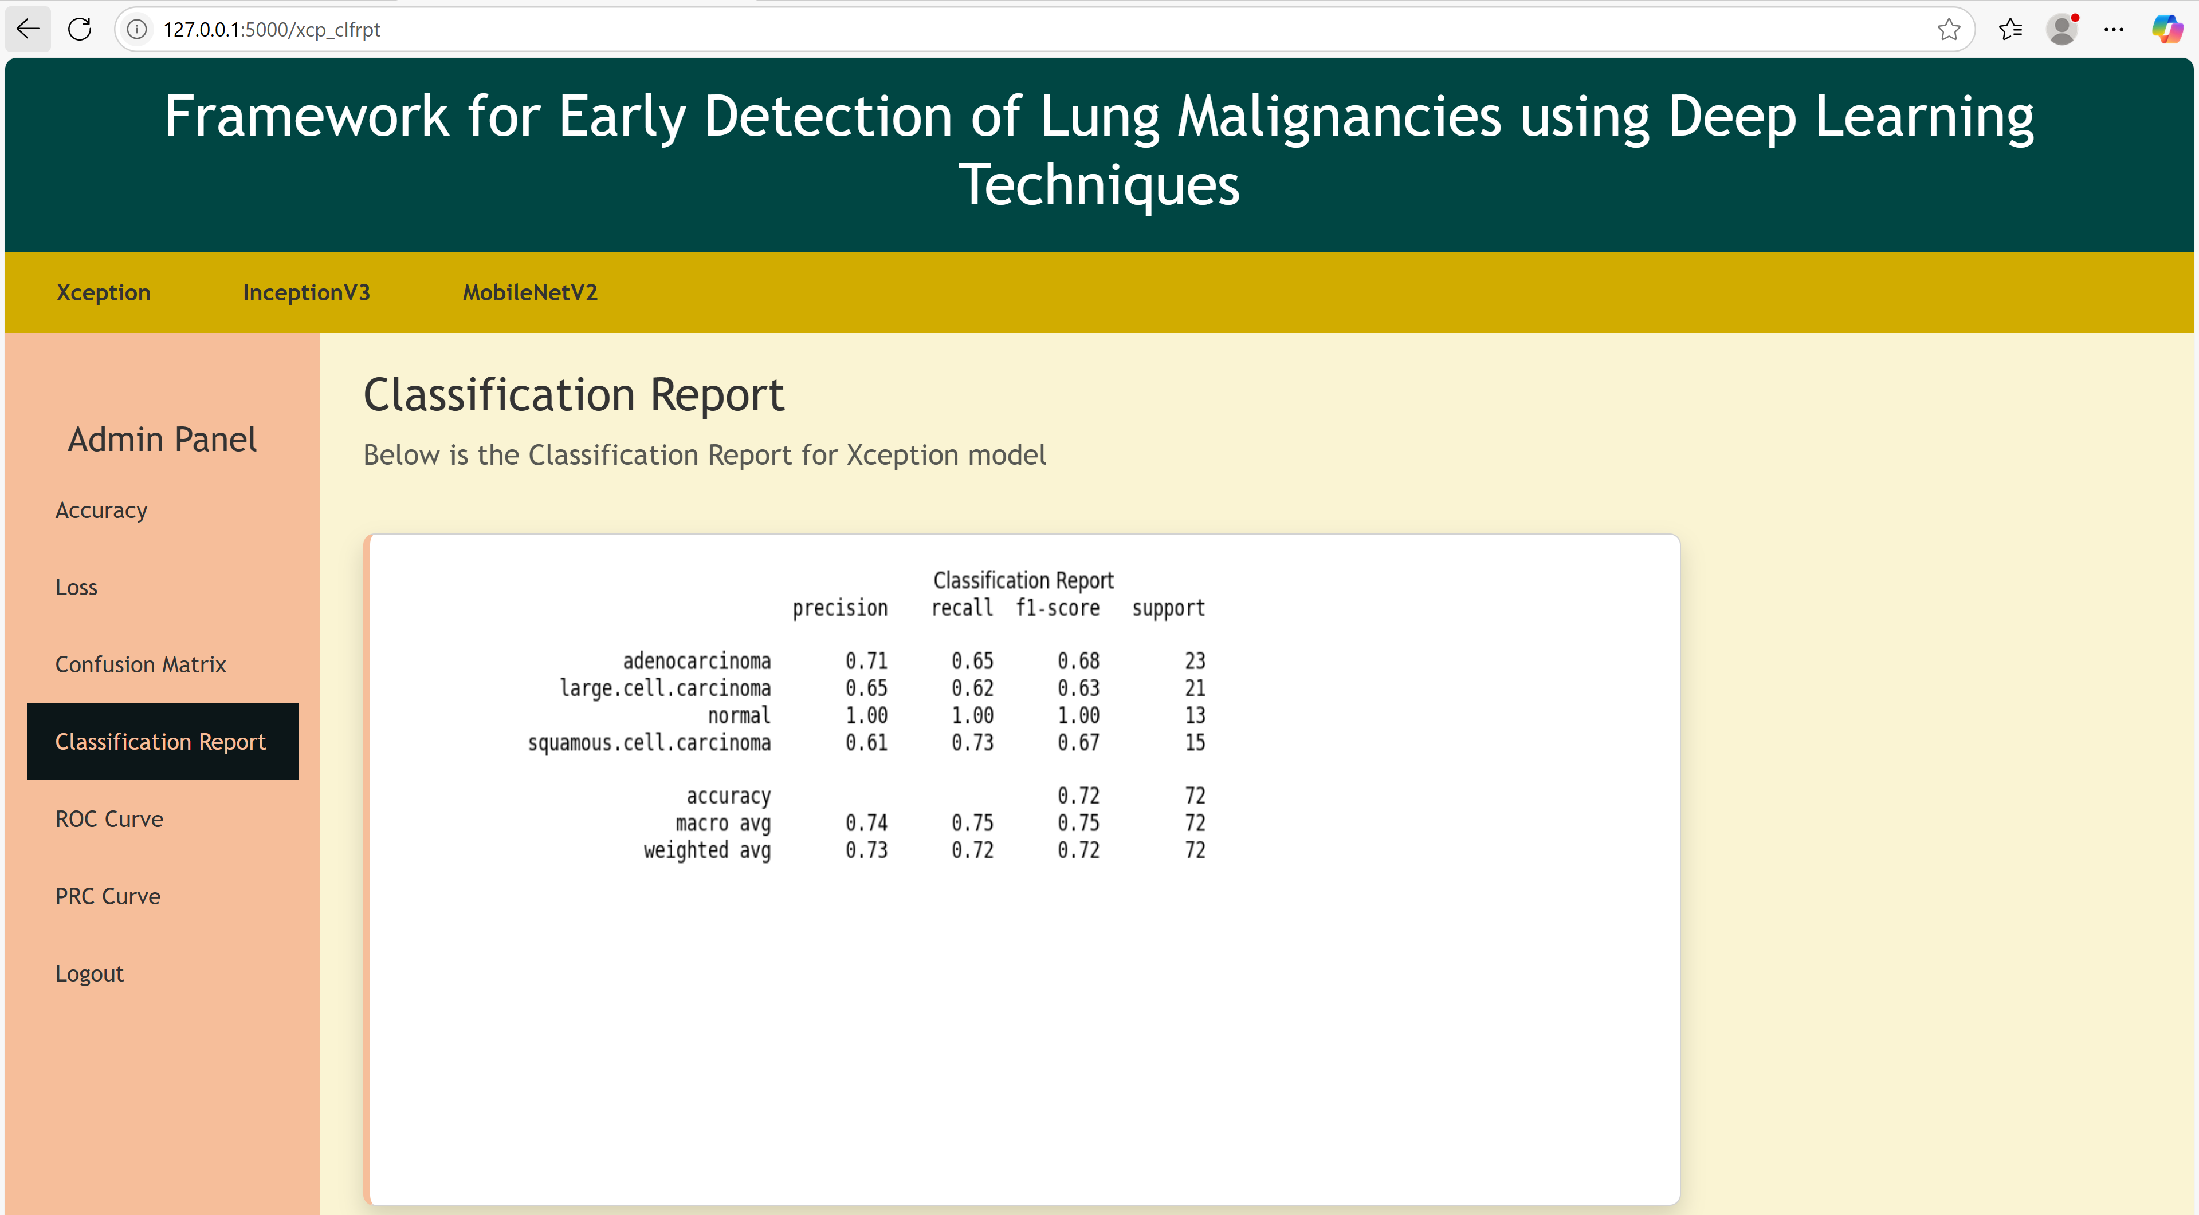

Slide 23
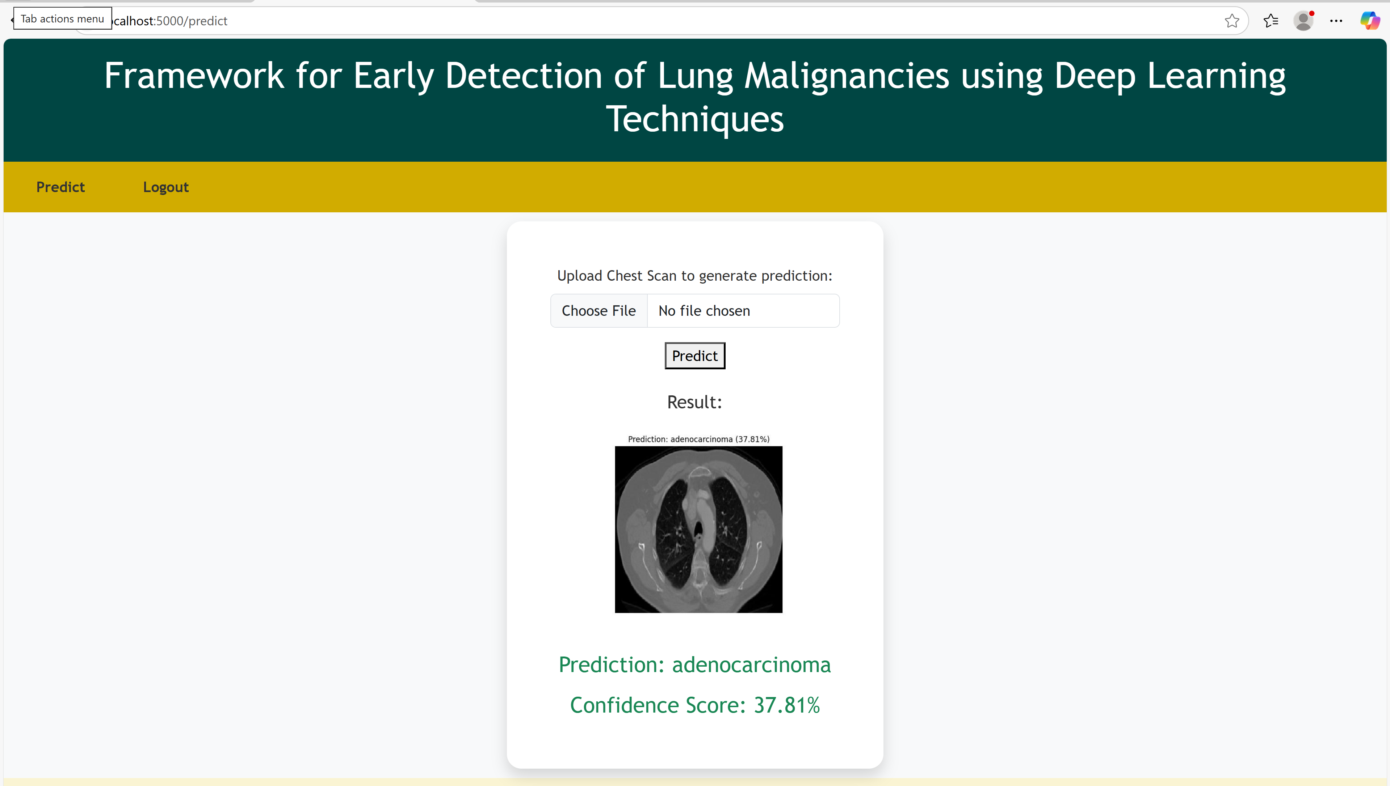

Slide 24
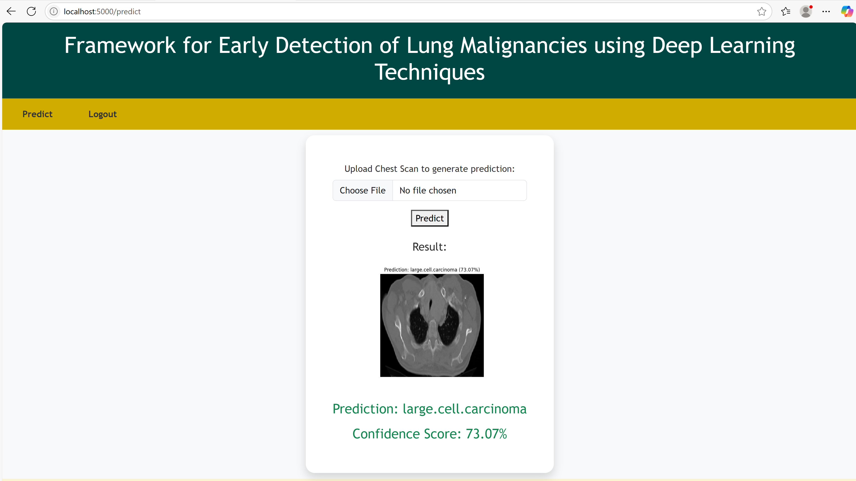

Slide 25
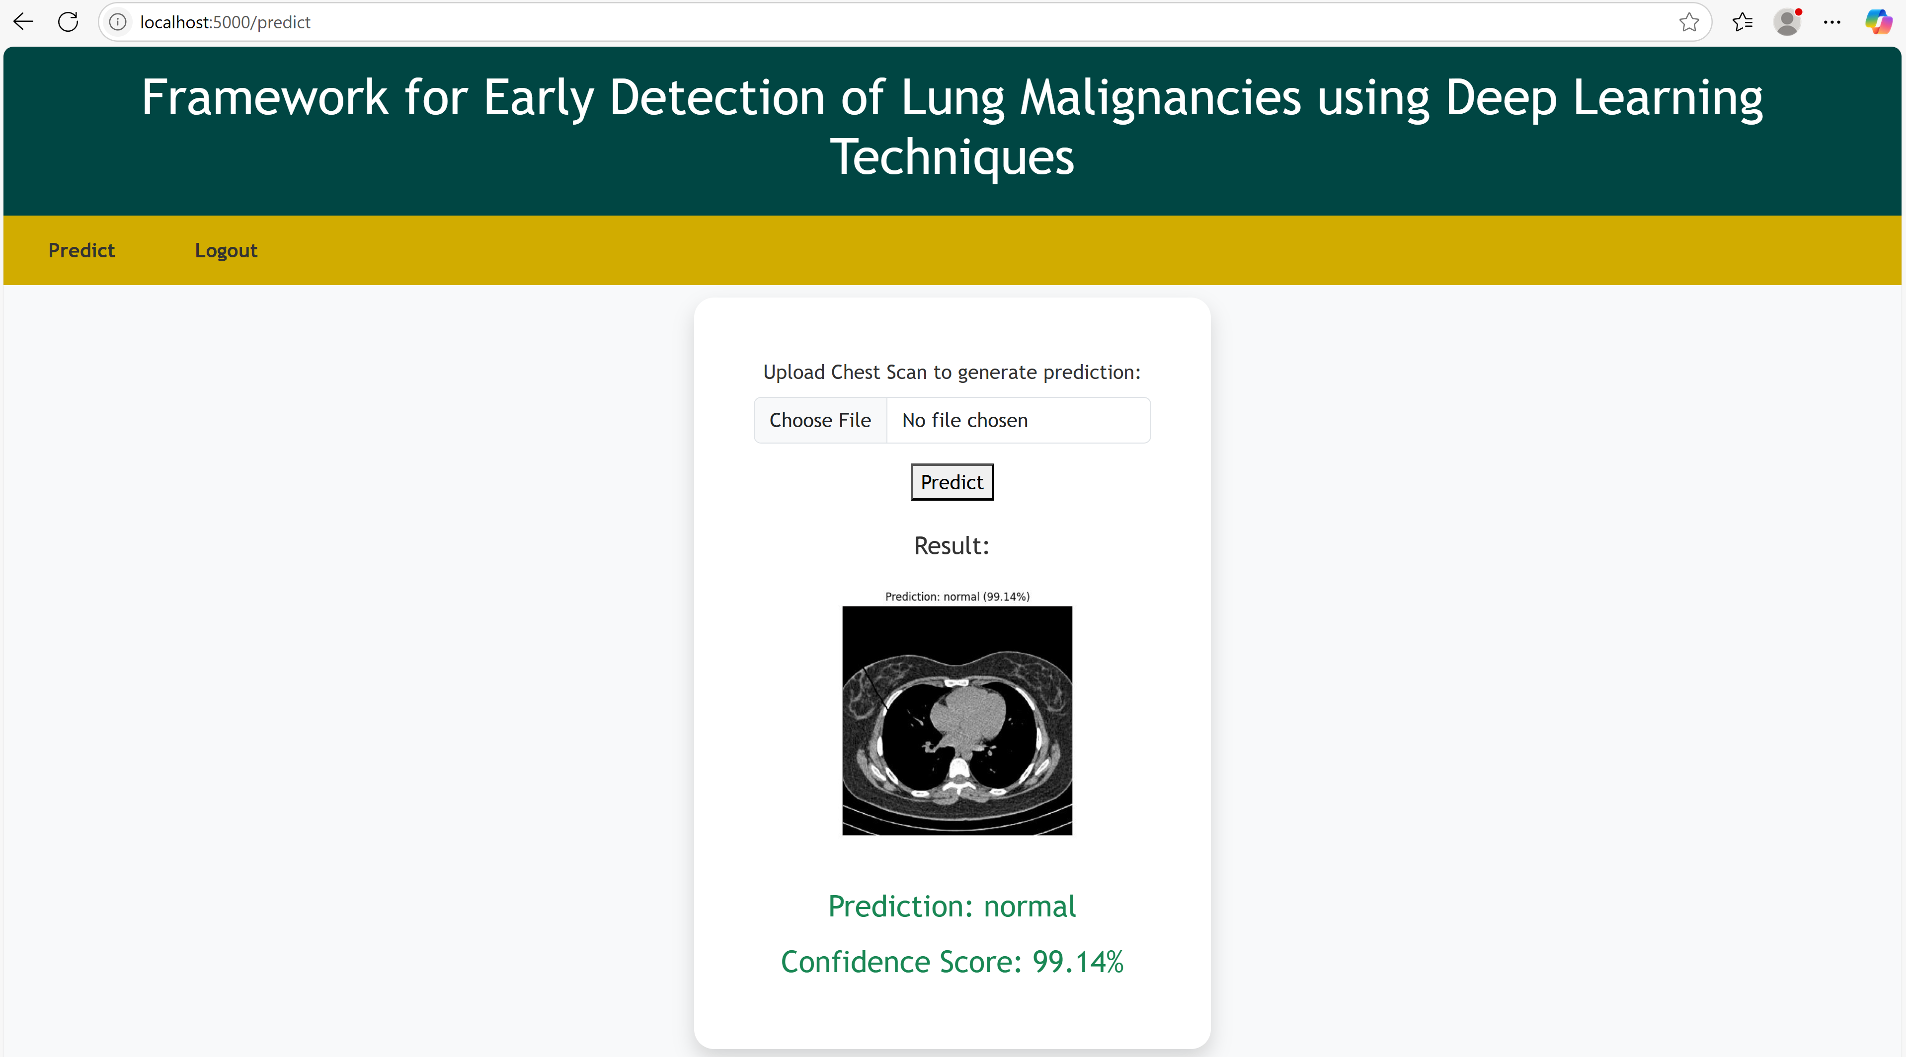

Slide 26
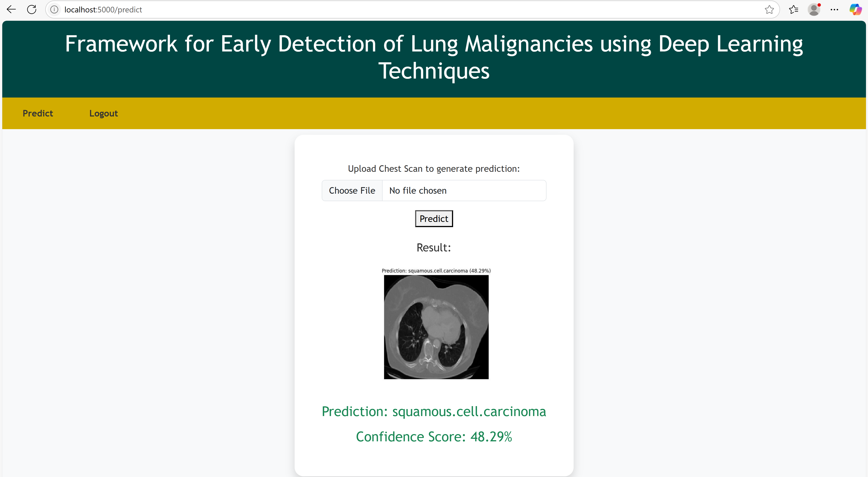

Slide 27
Conclusion
Deep learning models can greatly improve lung cancer detection accuracy.
ResNet-50 demonstrated strong performance among tested architectures.
Proposed system enhances reliability of computer-aided diagnosis.
Can be deployed in hospitals for faster screening.
Future scope includes real-time detection and integration with IoT.

Slide 28
Future Scope
Integration with hospital systems
Deployment as web application
Mobile-based cancer screening
Real-time AI diagnostic support

Slide 29
References
R. L. Siegel, K. D. Miller, H. E. Fuchs, and A. Jemal, “Cancer Statistics, 2021.,” CA. Cancer J. Clin., vol. 71, no. 1, pp. 7–33, Jan. 2021, doi: 10.3322/caac.21654.
S. Lei et al., “Global patterns of breast cancer incidence and mortality: A population‐based cancer registry data analysis from 2000 to 2020,” Cancer Commun., vol. 41, no. 11, pp. 1183 1194, 2021.
M. M. Cackowski et al., “The absence of lymph nodes removed (pNx status) impacts survival in patients with lung cancer treated surgically,” Surg. Oncol., vol. 48, p. 101941, 2023.
S. S. Raoof, M. A. Jabbar, and S. A. Fathima, “Lung Cancer Prediction using Machine Learning: A Comprehensive Approach,” in 2020 2nd International Conference on Innovative Mechanisms for Industry Applications (ICIMIA), 2020, pp. 108–115. doi: 10.1109/ICIMIA48430.2020.9074947.
J. Jumanto, M. F. Mardiansyah, R. Pratama, M. F. Al Hakim, and B. Rawat, “Optimization of breast cancer classification using feature selection on neural network,” J. Soft Comput. Explor., vol. 3, no. 2, pp. 105–110, 2022, doi: 10.52465/joscex.v3i2.78. B.

Slide 30
THANK YOU

